Slide 1
3D Computer Vision Practice
Introduction.
OpenCV installation and sample project.
Levente Hajder, Tamás Tófalvi, ...

Slide 2
3D Computer Vision Practice
Site: http://cg.elte.hu/index.php/computer-vision/
There will be assignments (for the practice) and one oral examination (for the lecture).
Final mark: oral exam (0-100%) + homework (0-100%) + extra scores (optional, given by the teachers).
Minimum requirement: 40% from Oral Exam and 40% from practice assignments

Slide 3
What is OpenCV?
OpenCV (Open Source Computer Vision Library) is a library of programming functions mainly aimed at real-time computer vision.
Applications:
egomotion estimation,
facial recognition system,
segmentation,
object detection,
motion tracking.
OpenCV is written in C++ and its primary interface is in C++.
There are bindings in Python, Java and MATLAB/OCTAVE.

Slide 4
OpenCV installation for Windows
Installation and configuration for Visual Studio 2022.

Slide 5
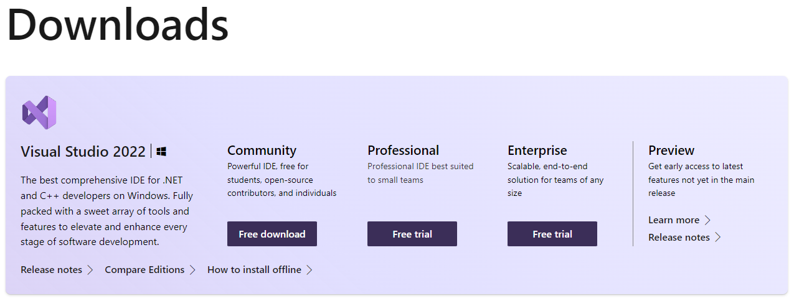
Step 1: Install the C++ Desktop development Workload
Go to https://visualstudio.microsoft.com/downloads/ and download Visual Studio 2022 Community Edition. (If you already have VS 2019 that works too).

Slide 6
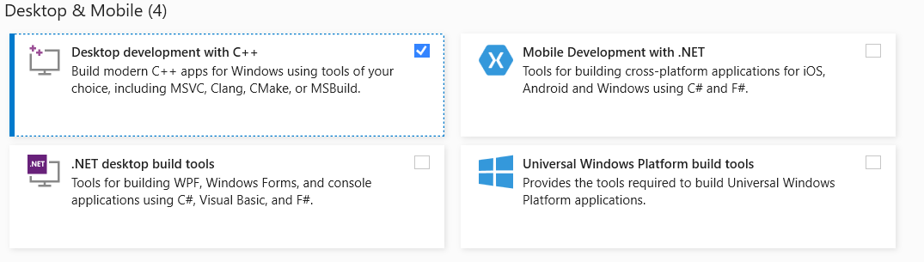
Step 1: Install the C++ Desktop development Workload
Start the Visual Studio Installer exe that you just downloaded and select Desktop development with C++.

Slide 7
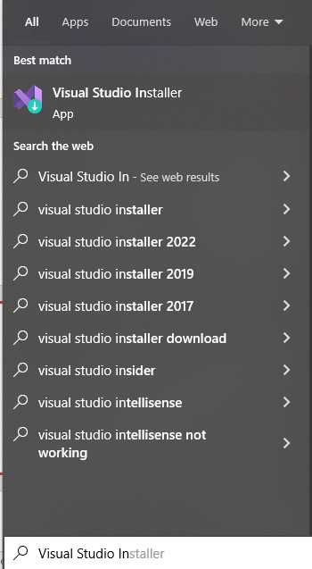
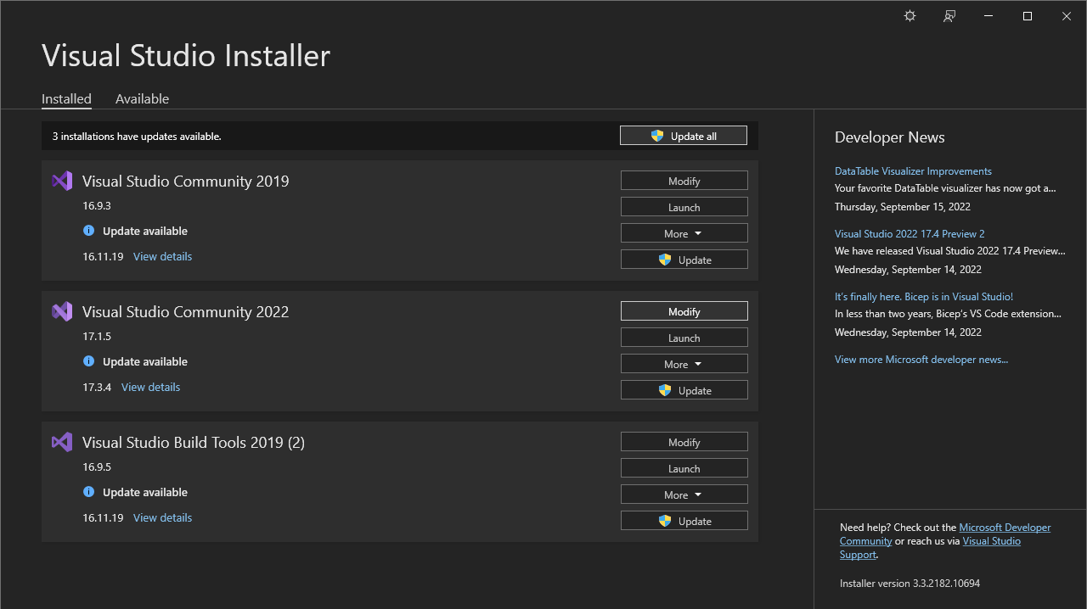
Step 1: Install the C++ Desktop development Workload
If you previously Installed Visual Studio 2022 without C++ then run Visual Studio Installer and click to Modify.

Slide 8
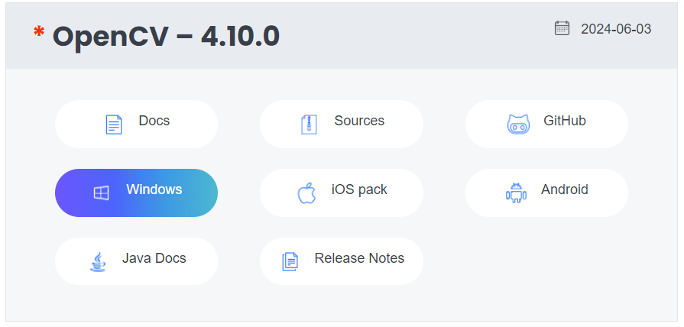

Step 2: Download and Install OpenCV-4.10.0
Download OpenCV 4.10.0 latest stable release (opencv-4.10.0-windows.exe) for Windows platform. Go to the official OpenCV website: https://opencv.org/ -> Library -> Releases and click on the Windows platform. You will be redirected to SourceForge and the download will automatically start.

Slide 9
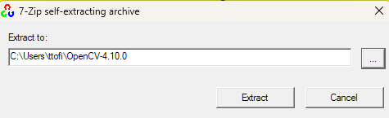
Step 2: Download and Install OpenCV-4.10.0
Create a folder where you want OpenCV installed
e.g. C:\Users\YourUserName\OpenCV-4.10.0
Run the installer and extract the contents there

Slide 10
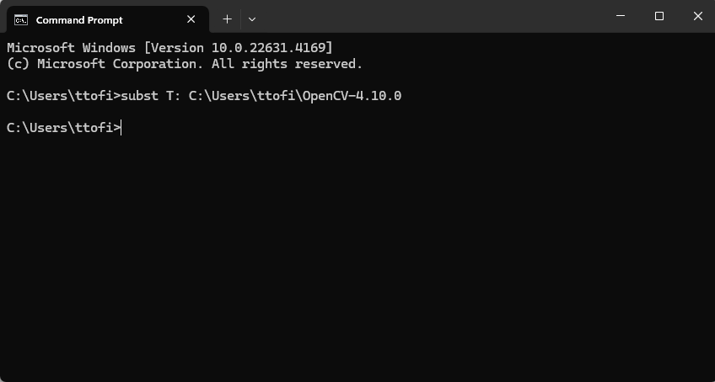
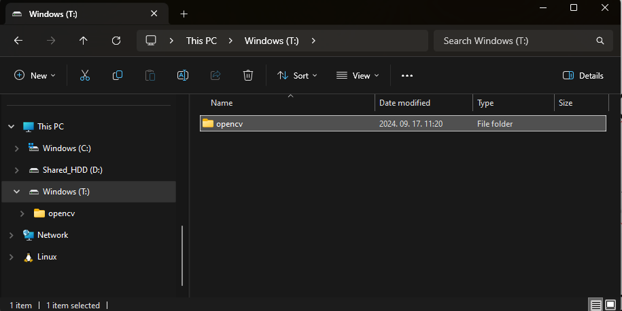
Step 3: Substitute partition
Open command line and type
subst T: C:\Path\To\OpenCV
This will create a virtual partition named T which point to path given as the second argument of the subst command e.g. C:\Path\To\OpenCV.
If you open the File Explorer you have to see the T partition and it has to contain the opencv folder.
If you made a mistake:
subst T: /d
to remove the T: partition

Slide 11
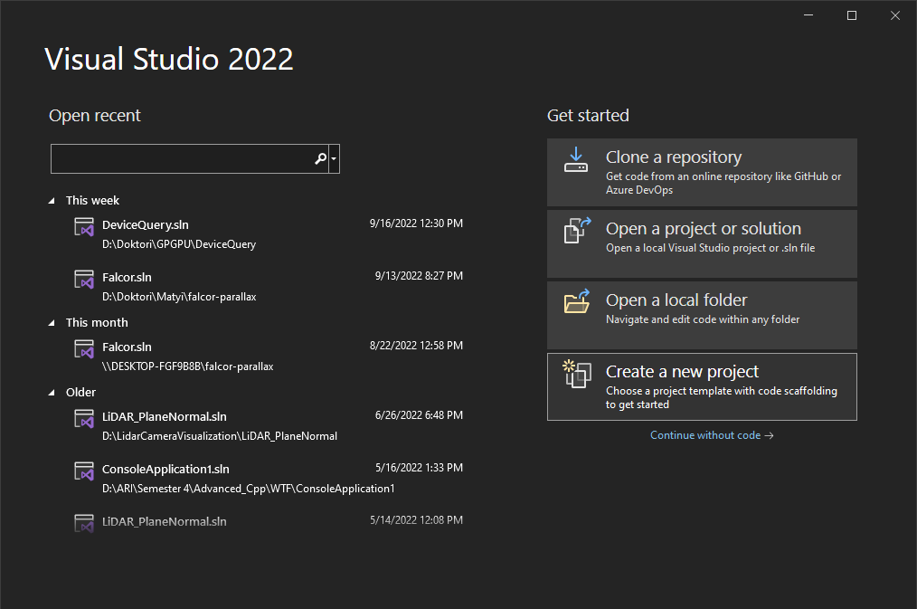
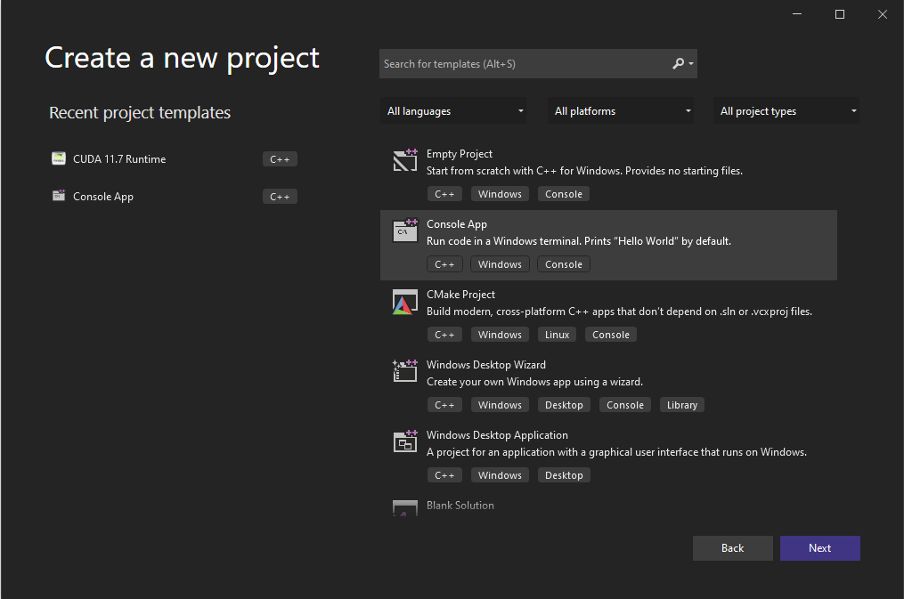
Step 4: Configure a Visual Studio project to run OpenCV
Open Visual Studio 2022, choose to create a new project and select the C++ Console App template.

Slide 12
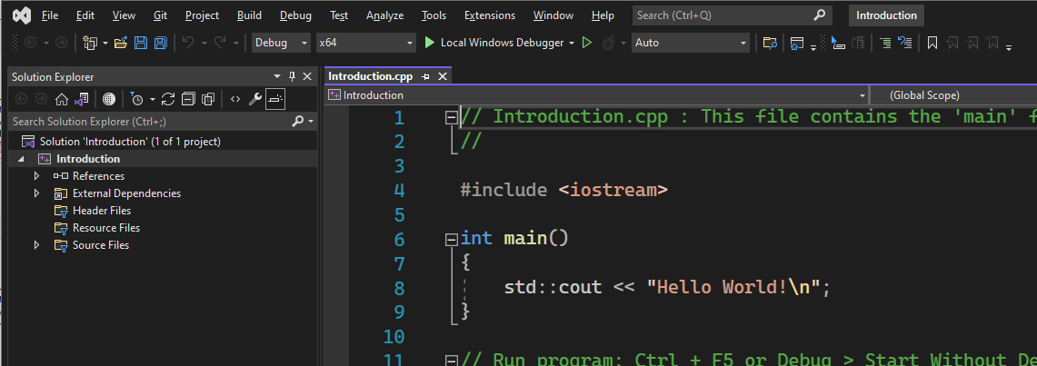
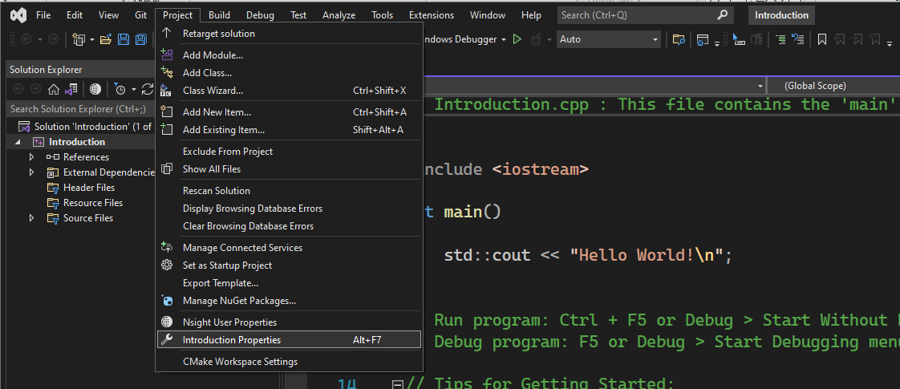
Step 4: Configure a Visual Studio project to run OpenCV
Change the solution from x86 to x64.
Make sure Debug is selected
Change the Project Properties to add OpenCV libraries.

Slide 13
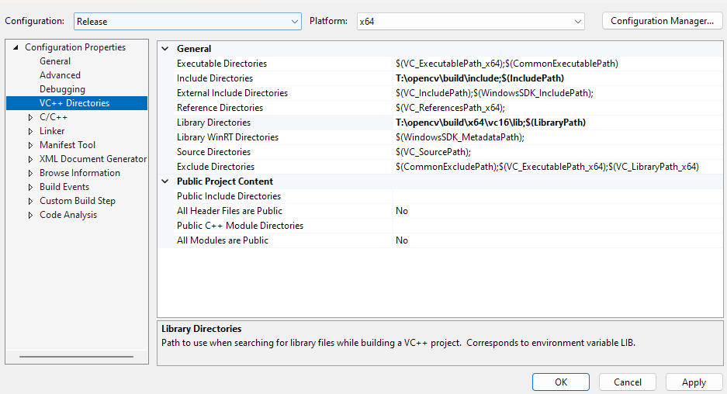
Step 4: Configure a Visual Studio project to run OpenCV
Go to Configuration Properties/VC++ Directories to add the include and library directories for OpenCV.

Slide 14
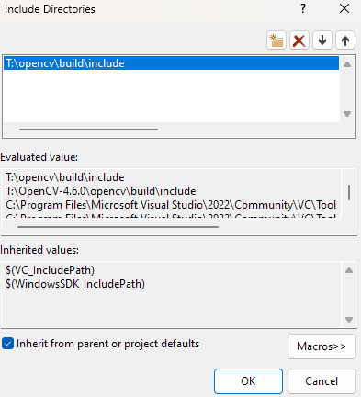
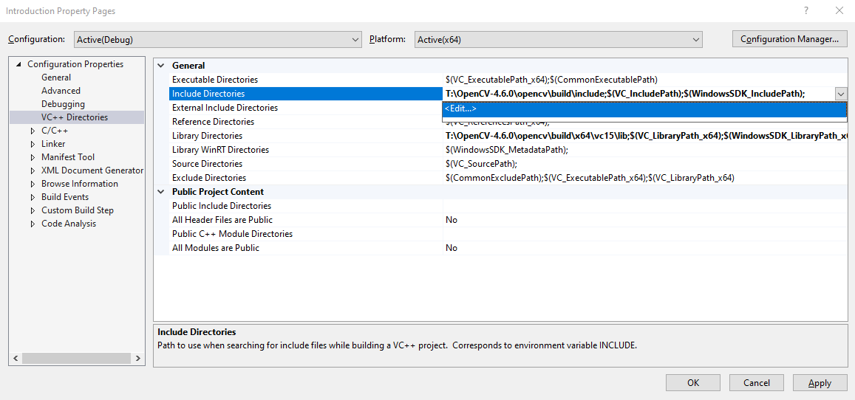
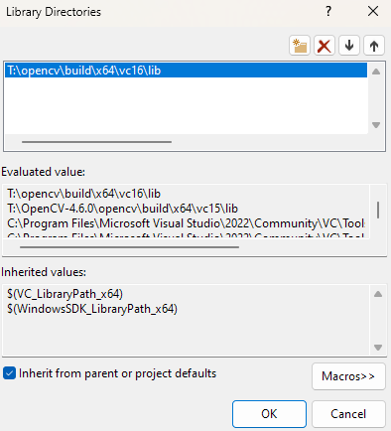
Step 4: Configure a Visual Studio project to run OpenCV
For the Include directories, you have to add the following path: T:\opencv\build\include.
Do the same for the Library Directories adding this internal path: T:\opencv\build\x64\vc16\lib.

Slide 15
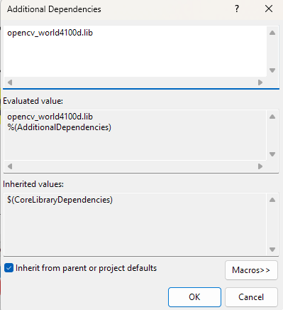
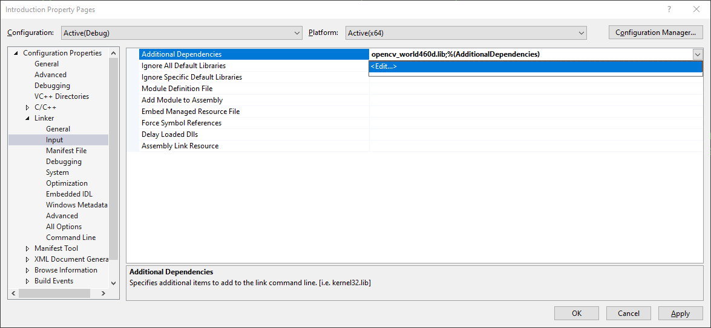
Step 4: Add OpenCV binaries to your System path
Edit the VC++ project linker with the opencv_world4100d.lib OpenCV dynamic library.
You will find the DLL (Dynamic Link Library) here: T:\opencv\build\x64\vc16\lib copy the name of the file opencv_world4100d.lib and paste it in the dependency box.
For Release mode use opencv_world4100.lib without the d at the end

Slide 16
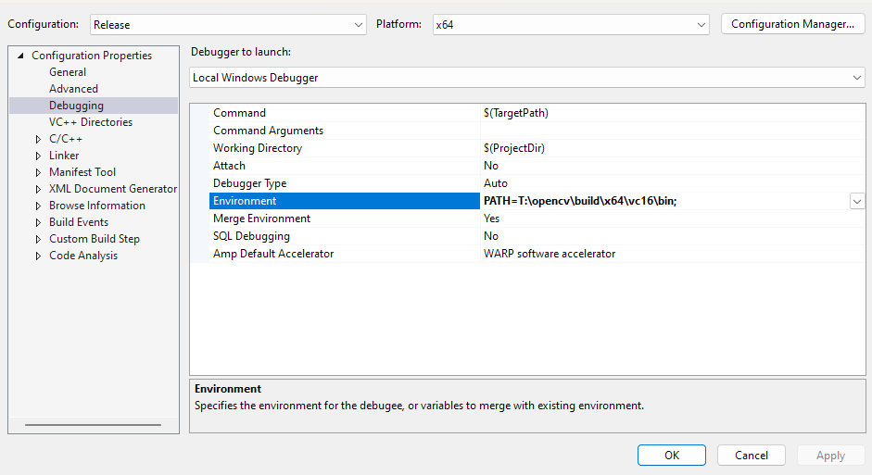
Step 4: Add OpenCV binaries to your System path
Add OpenCV binaries to the environment PATH via Visual Studion (project only!)
PATH=T:\opencv\build\x64\vc16\bin;
Make sure to include ; at the end!

Slide 17
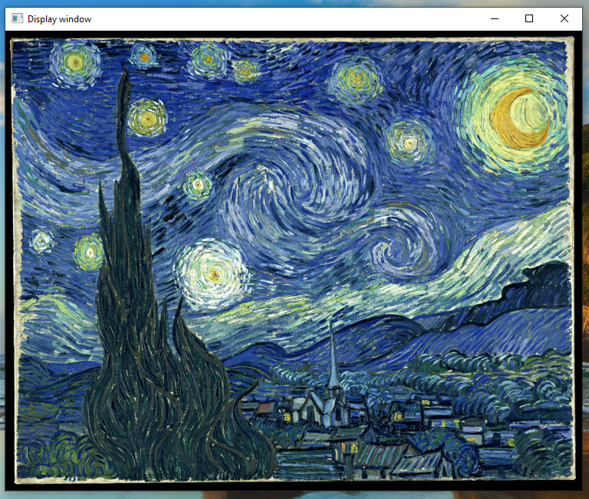
Step 5: Run sample code.
#include <opencv2/core.hpp>
#include <opencv2/imgproc.hpp>
#include <opencv2/highgui.hpp>
#include <iostream>
int main()
{
std::string image_path =
"T:\\OpenCV-4.6.0\\opencv\\sources\\samples\\data\\starry_night.jpg";
cv::Mat img = cv::imread(image_path, cv::IMREAD_COLOR);
if (img.empty())
{
std::cout << "Could not read the image: " << image_path << std::endl;
return 1;
}
cv::imshow("Display window", img);
int k = cv::waitKey(0); // Wait for a keystroke in the window
if (k == 's')
{
cv::imwrite("starry_night.png", img);
}
return 0;
}

Slide 18
Introduction to OpenCV
Understanding the sample code

Slide 19
Understanding the sample code.
Included OpenCV libraries for core functionalities, image processing and UI handling.
https://docs.opencv.org/4.6.0/
#include <opencv2/core.hpp>
#include <opencv2/imgproc.hpp>
#include <opencv2/highgui.hpp>
#include <iostream>
Iostream for basic input and output services for C++ programs.

Slide 20
Understanding the sample code.
int main()
{
std::string image_path =
"T:\\OpenCV 4.6.0\\opencv\\sources\\samples\\data\\starry_night.jpg";
cv::Mat img = cv::imread(image_path, cv::IMREAD_COLOR);
if (img.empty())
{
std::cout << "Could not read the image: " << image_path << std::endl;
return 1;
}
cv::imshow("Display window", img);
int k = cv::waitKey(0); // Wait for a keystroke in the window
if (k == 's')
{
cv::imwrite("starry_night.png", img);
}
return 0;
}
Loading „starry_night.jpg” sample image into „img” matrix.
Mat type represents multidimensional arrays.
With imread you can open an image at a given path and with the
ImreadModes enum you can set the color information.

Slide 21
Understanding the sample code.
int main()
{
std::string image_path =
"T:\\OpenCV 4.6.0\\opencv\\sources\\samples\\data\\starry_night.jpg";
cv::Mat img = cv::imread(image_path, cv::IMREAD_COLOR);
if (img.empty())
{
std::cout << "Could not read the image: " << image_path << std::endl;
return 1;
}
cv::imshow("Display window", img);
int k = cv::waitKey(0); // Wait for a keystroke in the window
if (k == 's')
{
cv::imwrite("starry_night.png", img);
}
return 0;
}
Loading „starry_night.jpg” sample image into „img” matrix.
Mat type represents multidimensional arrays.
With imread you can open an image at a given path and with the
ImreadModes enum you can set the color information.
Checking whether it could open the image.

Slide 22
Understanding the sample code.
int main()
{
std::string image_path =
"T:\\OpenCV 4.6.0\\opencv\\sources\\samples\\data\\starry_night.jpg";
cv::Mat img = cv::imread(image_path, cv::IMREAD_COLOR);
if (img.empty())
{
std::cout << "Could not read the image: " << image_path << std::endl;
return 1;
}
cv::imshow("Display window", img);
int k = cv::waitKey(0); // Wait for a keystroke in the window
if (k == 's')
{
cv::imwrite("starry_night.png", img);
}
return 0;
}
Loading „starry_night.jpg” sample image into „img” matrix.
Mat type represents multidimensional arrays.
With imread you can open an image at a given path and with the
ImreadModes enum you can set the color information.
Checking whether it could open the image.
Showing the image on a window named „Display window”.

Slide 23
Understanding the sample code.
int main()
{
std::string image_path =
"T:\\OpenCV 4.6.0\\opencv\\sources\\samples\\data\\starry_night.jpg";
cv::Mat img = cv::imread(image_path, cv::IMREAD_COLOR);
if (img.empty())
{
std::cout << "Could not read the image: " << image_path << std::endl;
return 1;
}
cv::imshow("Display window", img);
int k = cv::waitKey(0); // Wait for a keystroke in the window
if (k == 's')
{
cv::imwrite("starry_night.png", img);
}
return 0;
}
Loading „starry_night.jpg” sample image into „img” matrix.
Mat type represents multidimensional arrays.
With imread you can open an image at a given path and with the
cv::ImreadModes enum you can set the color information.
Checking whether it could open the image.
Showing the image on a window named „Display window”.
If the user pressed the „s” key, save the image.

Slide 24
Introduction to OpenCV
Basic UI event handling

Slide 25
Basic UI event handling
Next we are going to understand how to handle basic keyboard and mouse events using OpenCV.
For this purpose we are going to render a rectangle on the window that we can move with our keyboard and mouse.

Slide 26
Event handling – Defining a few variables
#include <opencv2/core.hpp>
#include <opencv2/imgproc.hpp>
#include <opencv2/highgui.hpp>
#include <iostream>
#define WIDTH 800
#define HEIGHT 600
cv::Mat image;
int xCoord, yCoord;
Define window width and height, a Mat for storing the image visualized inside the window and the coordinates of the rectangle that we will show.
These should be before the main() function.

Slide 27
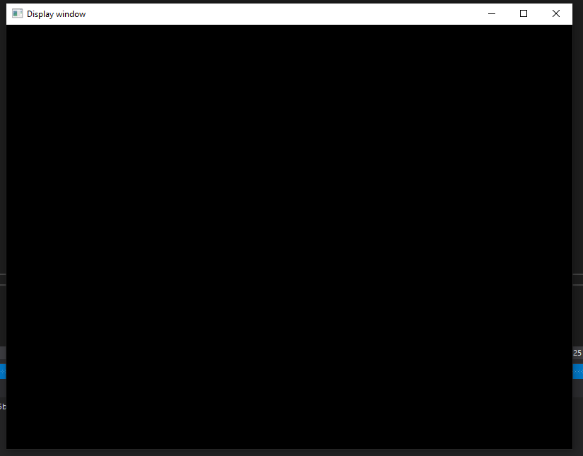
Event handling - Displaying a black image
int main()
{
image = cv::Mat::zeros(HEIGHT, WIDTH, CV_8UC3);
cv::namedWindow("Display window", cv::WINDOW_AUTOSIZE);
cv::imshow("Display window", image);
int key = cv::waitKey(0);
return 0;
}
Filling the image with zeros. (Meaning all three channels of the RGB will be 0 resulting a black image)

Slide 28
Event handling - Displaying a black image
Type of values stored in the cv::Mat image we created
int main()
{
image = cv::Mat::zeros(HEIGHT, WIDTH, CV_8UC3);
cv::namedWindow("Display window", cv::WINDOW_AUTOSIZE);
cv::imshow("Display window", image);
int key = cv::waitKey(0);
return 0;
}
Filling the image with zeros. (Meaning all three channels of the RGB will be 0 resulting a black image)

Slide 29
Event handling - Displaying a black image
Unsigned 8 bits (range 0…255)
int main()
{
image = cv::Mat::zeros(HEIGHT, WIDTH, CV_8UC3);
cv::namedWindow("Display window", cv::WINDOW_AUTOSIZE);
cv::imshow("Display window", image);
int key = cv::waitKey(0);
return 0;
}
Filling the image with zeros. (Meaning all three channels of the RGB will be 0 resulting a black image)

Slide 30
Event handling - Displaying a black image
Unsigned 8 bits (range 0…255)
3 channels corresponding to the RGB values
int main()
{
image = cv::Mat::zeros(HEIGHT, WIDTH, CV_8UC3);
cv::namedWindow("Display window", cv::WINDOW_AUTOSIZE);
cv::imshow("Display window", image);
int key = cv::waitKey(0);
return 0;
}
Filling the image with zeros. (Meaning all three channels of the RGB will be 0 resulting a black image)

Slide 31
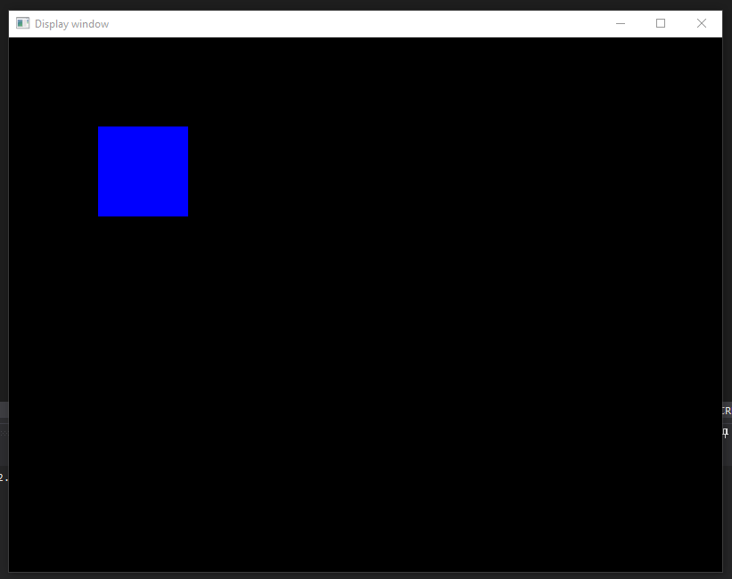
Event handling – Drawing a rectangle
void redraw() {
cv::rectangle(image, cv::Point(0, 0), cv::Point(WIDTH, HEIGHT), cv::Scalar(0, 0, 0), cv::FILLED);
cv::rectangle(image, cv::Point(xCoord, yCoord), cv::Point(xCoord + 100, yCoord + 100), cv::Scalar(255, 0, 0), cv::FILLED);
cv::imshow("Display window", image);
}
int main()
{
image = cv::Mat::zeros(600, 800, CV_8UC3);
xCoord = 100;
yCoord = 100;
redraw();
cv::namedWindow("Display window", cv::WINDOW_AUTOSIZE);
cv::imshow("Display window", image);
int key = cv::waitKey(0);
return 0;
}
Using the cv::rectangle function we can create rectangles. The parameters: the image to draw on, the top left corner of the rectangle, the bottom right corner of the rectangle, the color and whether it is filled or not.

Slide 32
Event handling – Moving the rectangle
int key;
int speed = 10;
while (true) {
key = cv::waitKey(100);
if (key == 27) break;
switch (key) {
case 'a':
xCoord -= speed;
break;
case 'd':
xCoord += speed;
break;
case 'w':
yCoord -= speed;
break;
case 's':
yCoord += speed;
break;
}
redraw();
}
return 0;
}
Using a while loop and a switch statement wait for the user to press a key on the keyboard.
If the pressed key is ESC (key == 27) exit.
If the user presses ‘w’, ‘a’, ‘s’ or ’d’ move the rectangle on the screen with speed (10) pixels.

Slide 33
Event handling – Using mouse events
void MouseCallBackFunc(int event, int x, int y, int flags, void* userdata)
{
if (event == cv::EVENT_LBUTTONDOWN)
{
xCoord = x;
yCoord = y;
redraw();
}
}
int main()
{
image = cv::Mat::zeros(HEIGHT, WIDTH, CV_8UC3);
xCoord = 100;
yCoord = 100;
redraw();
cv::namedWindow("Display window", cv::WINDOW_AUTOSIZE);
cv::imshow("Display window", image);
cv::setMouseCallback("Display window", MouseCallBackFunc, NULL);
Mouse callback function:
Handles a mouse event with the following parameters:
Event : Type of the mouse event.
X,Y coordinates.
Flags: Specific condition whenever a mouse event occurs.
Userdata: Any pointer passed to the „setMouseCallback" function as the 3rd parameter.
Setting a mouse callback function for the window named „Display window”.

Slide 34
Bouncing ball
Homework for 6 points. Deadline: 2023/03/20.
Submission: Canvas.

Slide 35
Homework: Bouncing ball
Bouncing ball: You have to write a small game.
The window itself is the field, it bordered by three walls (left, right, top).
The fourth side (bottom) is open, there is a racket at that side.
There is also a ball in the field, its speed is constant. It bounces back from both the walls and the racket. It can fall down at the bottom.
The racket has to be controllable by mouse and/or keyboard.
If the ball falls down, the game exists.
Deadline: in 2 weeks
Points: 6 points.
Submission: Canvas. (The canvas for the practice will be created this week.) https://canvas.elte.hu/ - login with NEPTUN

Slide 36
Thank you for your attention!

